Slide 1

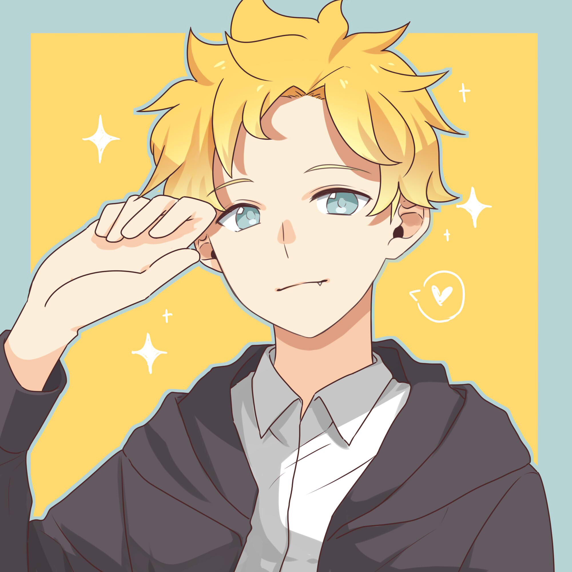



























Anime List
Manga List
malgraph
Comments
About Me
Message
nattadasu
3,5
Mean Score (Anime)
^{Lvl} 13
mal badges
Free of Charge
18
Age
Hello, and welcome to my profile! ^^)/
I’m Natsu Tadama (aliased, but you can also find my real name easily tbh), and I’m “he/him”. Came from Indonesia, so if you notice I spoke so weirdly (like this sentence lol), please forgive me and correct my spelling :’)
Talking about myself, I’d say that I’ve become otaku (not weeaboo, note it please) since February 2016 with my not-so-first anime called “Tokyo Ghoul.” I can speak in more than 5 languages: Acehnese, Indonesian, Malay, English, Arabic, and Japanese... With some plot twists, I can read the Cyrillic alphabet and Hangul. Oh, I’m also Fudanshi, hehehe.
That’s all the short info about me :3
You can continue to stalk me, if you wonder to ( ͡° ͜ʖ ͡°), with clicking that button below.
Show More \(>o<)/
Information
Name | Natsu Tadama
Address | Aceh, Indonesia
Joined to MyAnimeList | Mar 11, 2016
Birthday | Jun 4, 2001
Languages | Acehnese, Indonesia, English, Arabic, Japanese
Layout Designer | @nattadasu
User Website
Shortcuts
Cards
Add as Friend
Send DM
Recommendations
Clubs
Favorite Genres
Comedy
Fantasy
Slice of Life
School
Romance
Contacts
Kitsu
AniList
SIMKL
AP
aniSearch
MyShows
Trakt
Шикимори
TV Time
Goodreads
Last.fm
Discord
Wikipedia
Instagram
osu!
Designed by nattadasu in Aceh, Indonesia. Latest update: 4:04 AM Mar 17, 2020 GMT+7.

